Slide 1
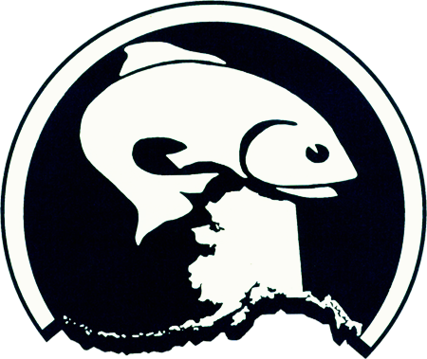

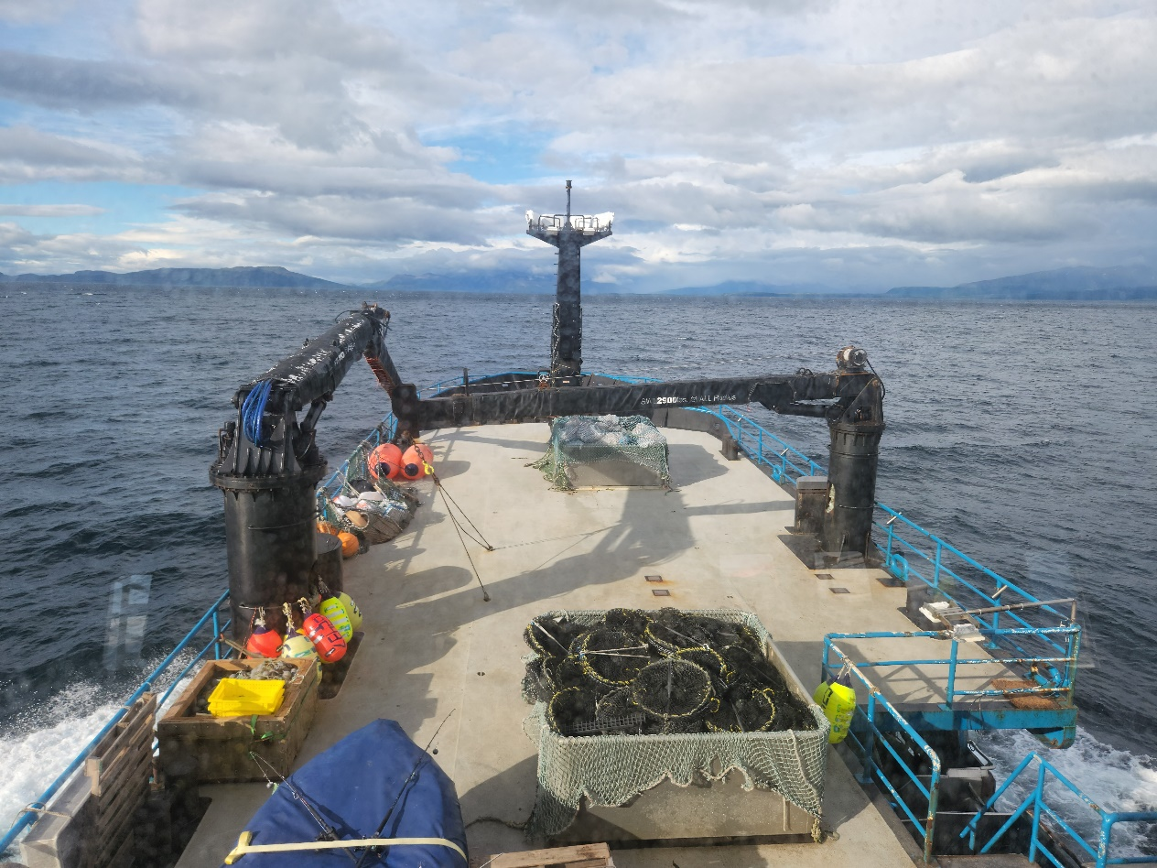
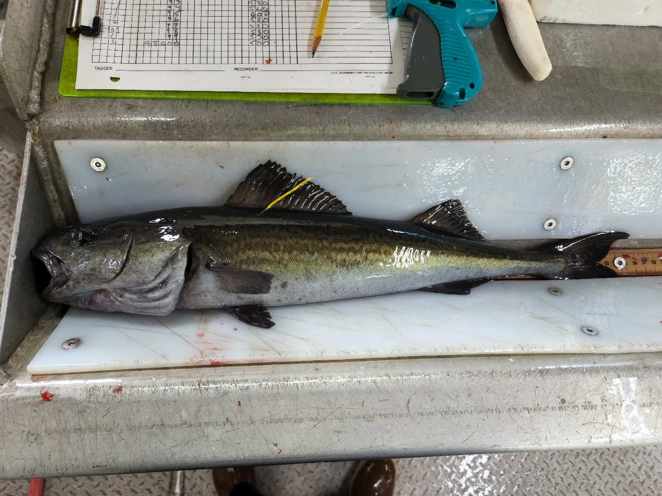

Sablefish Assessment: Available Data
2026 CIE Review
Daniel Goethel and Matt Cheng
Contributors: Kevin Siwicke and Katy Echave
June 2026

Slide 2
Agenda

Slide 3
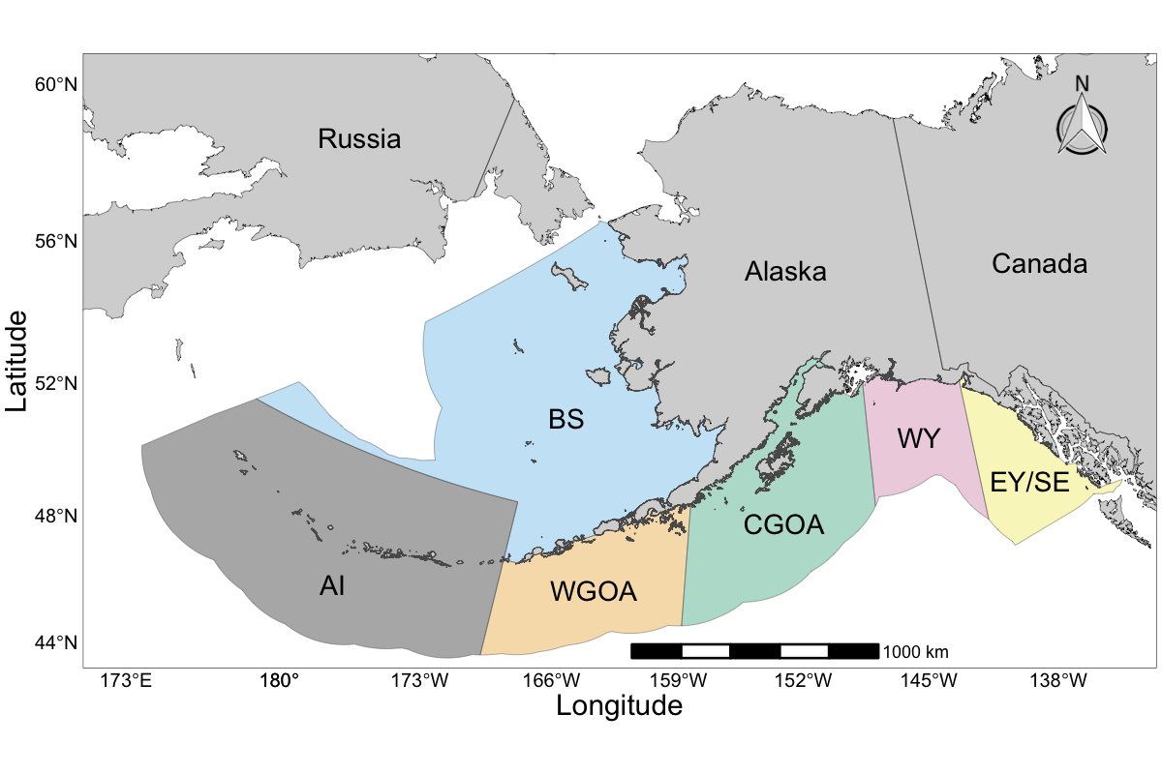
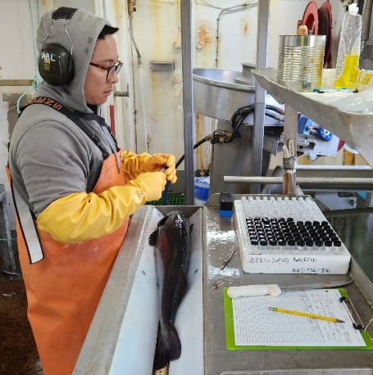
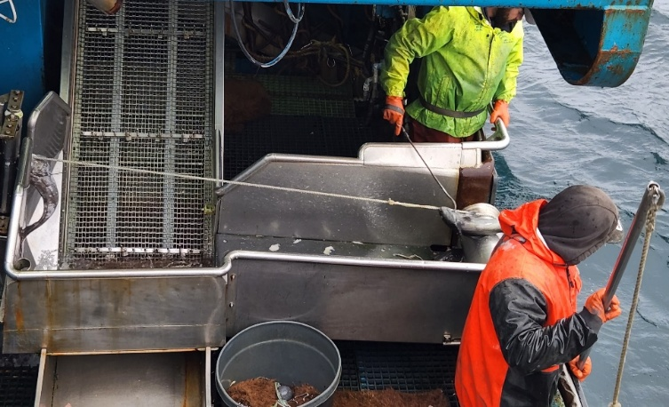
Issues to Consider: Data Inputs
What is the best approach for constructing a single region NOAA Longline Survey?
Is the ‘carryover’ extrapolation method appropriate?
Are all data truly representative of the Alaska-wide stock?
Does integrating CPUE or GOA trawl survey improve model performance?
When do length composition data improve the model?
If age compositions exist from a given data source, should length compositions be removed?
Are regional age composition sample sizes sufficient for use in the fleets-as-areas (FAA) model?

Slide 4
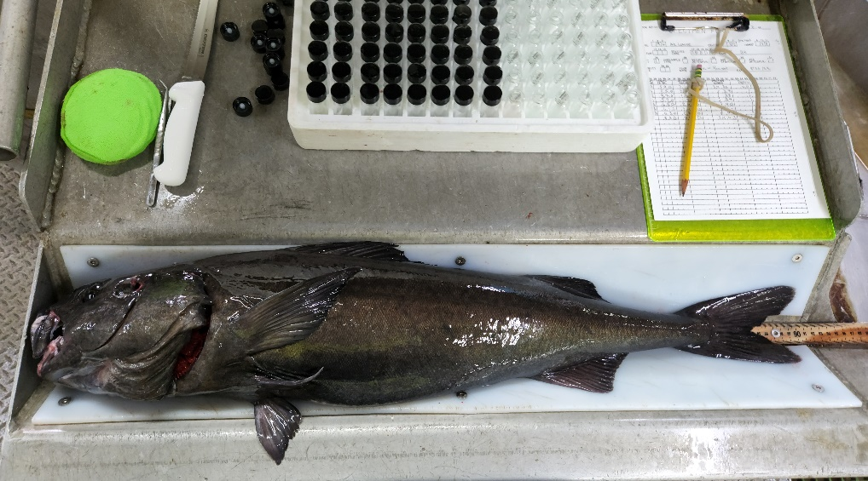
Data Summary
New data for 2026 in bold
Whale depredation by area held constant at 2022 levels
Data removed since 2025 (Model 25.12) is text
Source | Data | Years
Fixed Gear Fisheries | Catch | 1960 – 2025
Trawl Fisheries | Catch | 1960 – 2025
Non-Commercial Catch | Catch | 1977 – 2025
Japanese Longline Fishery | Catch-per-Unit-Effort (CPUE) | 1964 – 1981
U.S. Fixed Gear Fisheries | CPUE | 1995 – 2022
 | Length | 1990 – 1998
 | Age | 1999 – 2024
U.S. Trawl Fisheries | Length | 1990,1991,1999, 2005 – 2024
Japan-U.S. Cooperative Longline Survey | RPNs, Length | 1979 - 1994
 | Age | 1981, 1985, 1987, 1989, 1991, 1993
NOAA Domestic Longline Survey | RPNs | 1990 – 2023, 2025
 | Length | 1990 – 1995
 | Age | 1996 – 2023

Slide 5
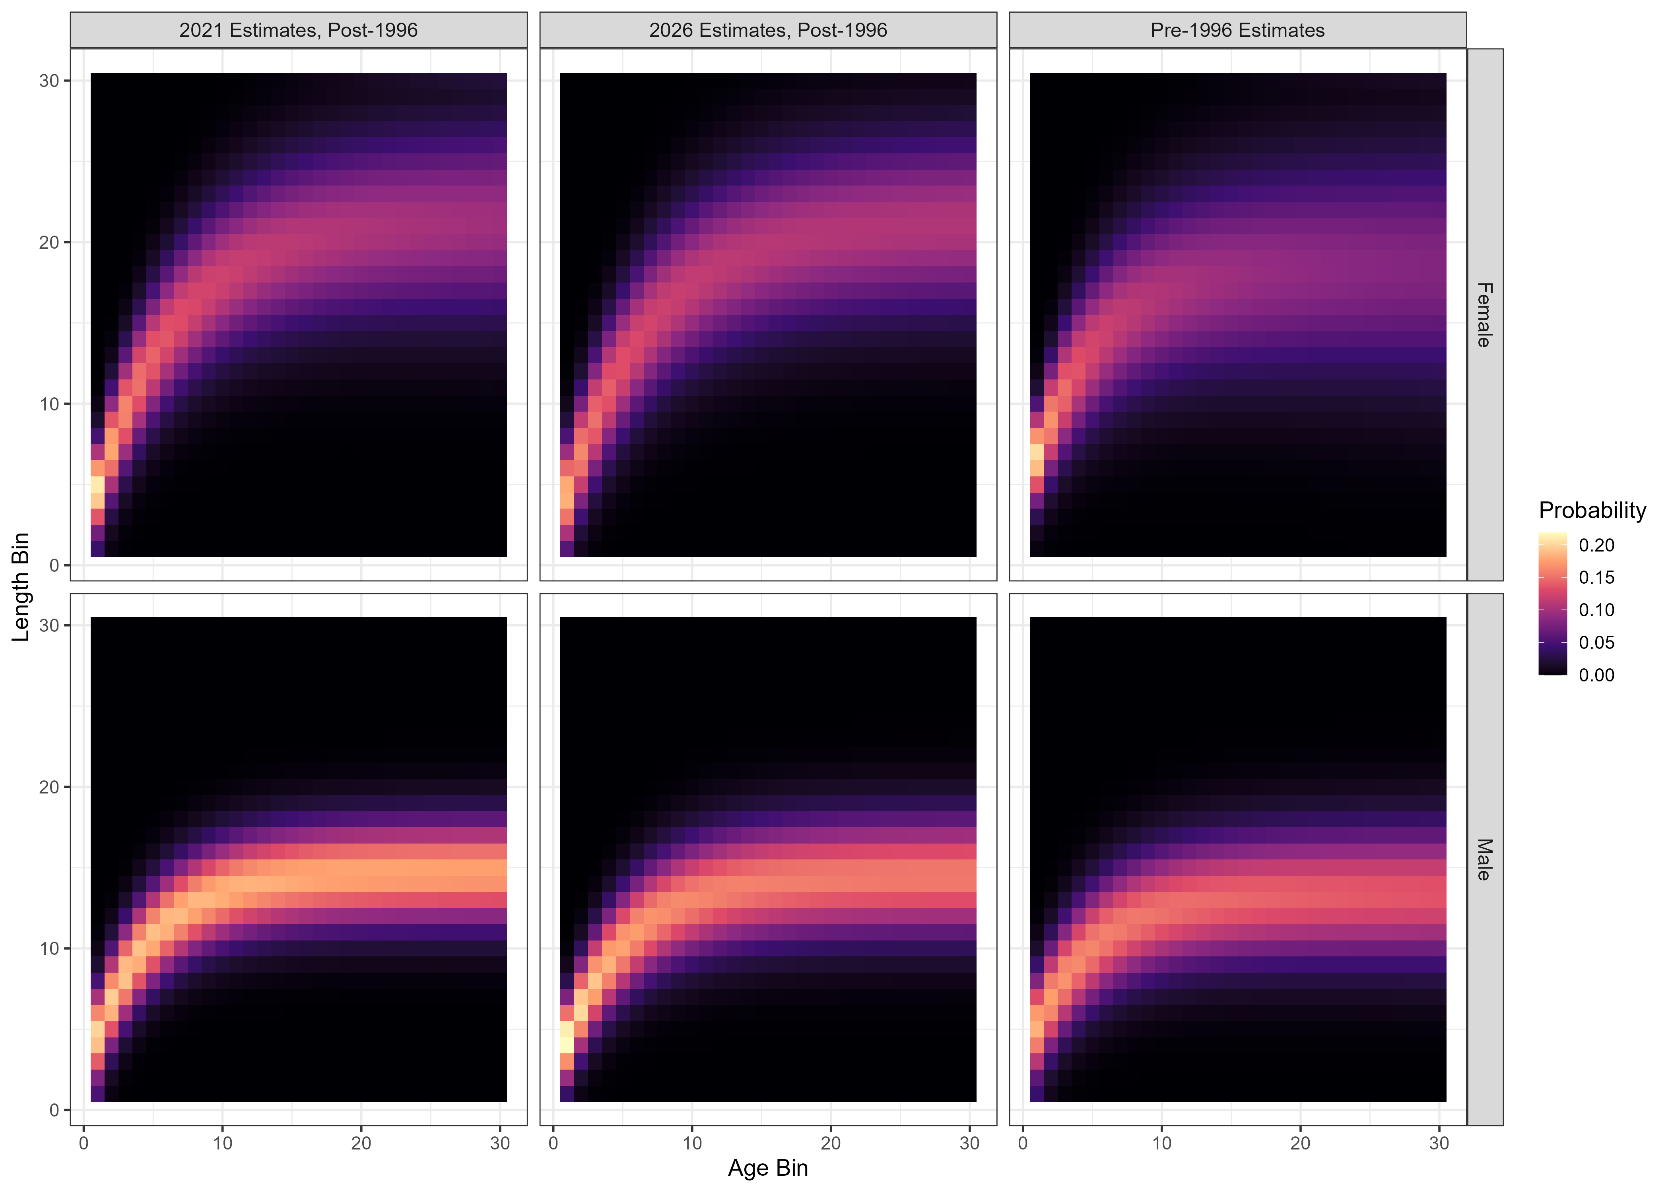
Biological Inputs
Updated size-age transition matrix and weight-at-age in 2026 with NOAA LLS age-length-weight pairs through 2023
Ageing error matrix based on known age otoliths
Maturity-at-age based on histological samples
Natural mortality prior ~N(ln(0.085), 0.1²) based on longevity and tagging estimates

Slide 6
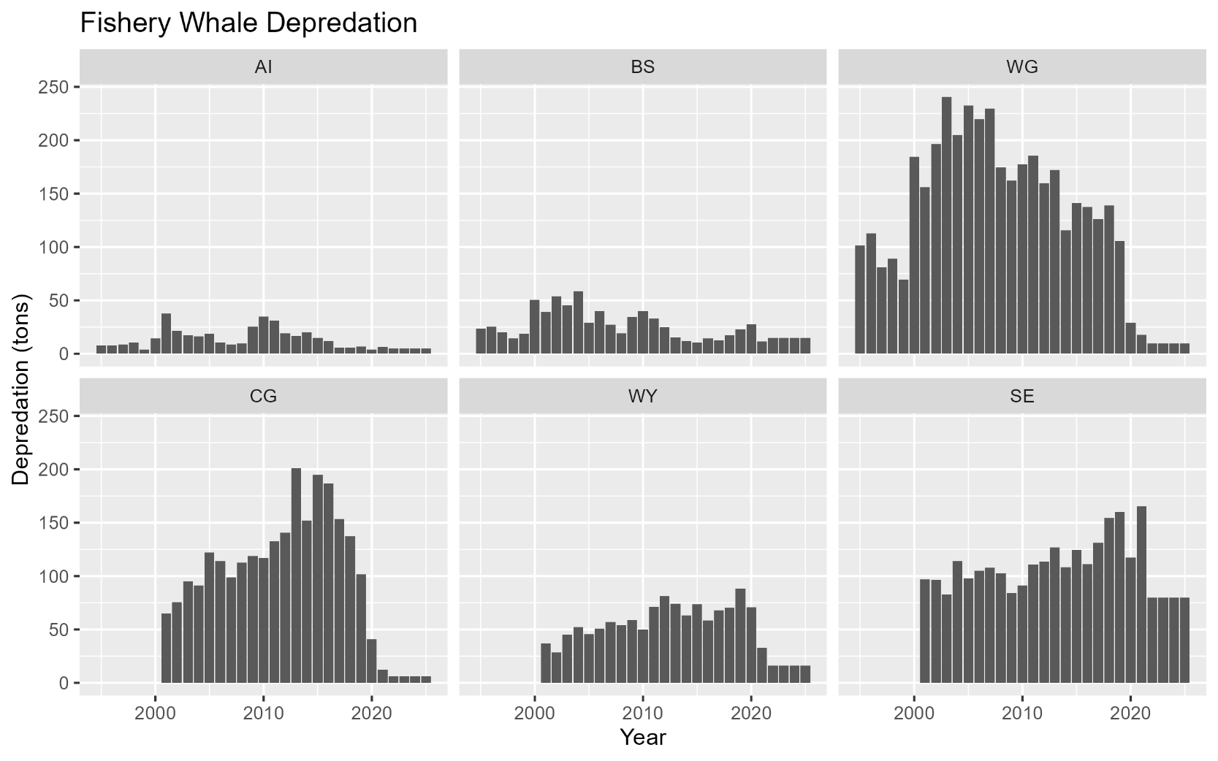
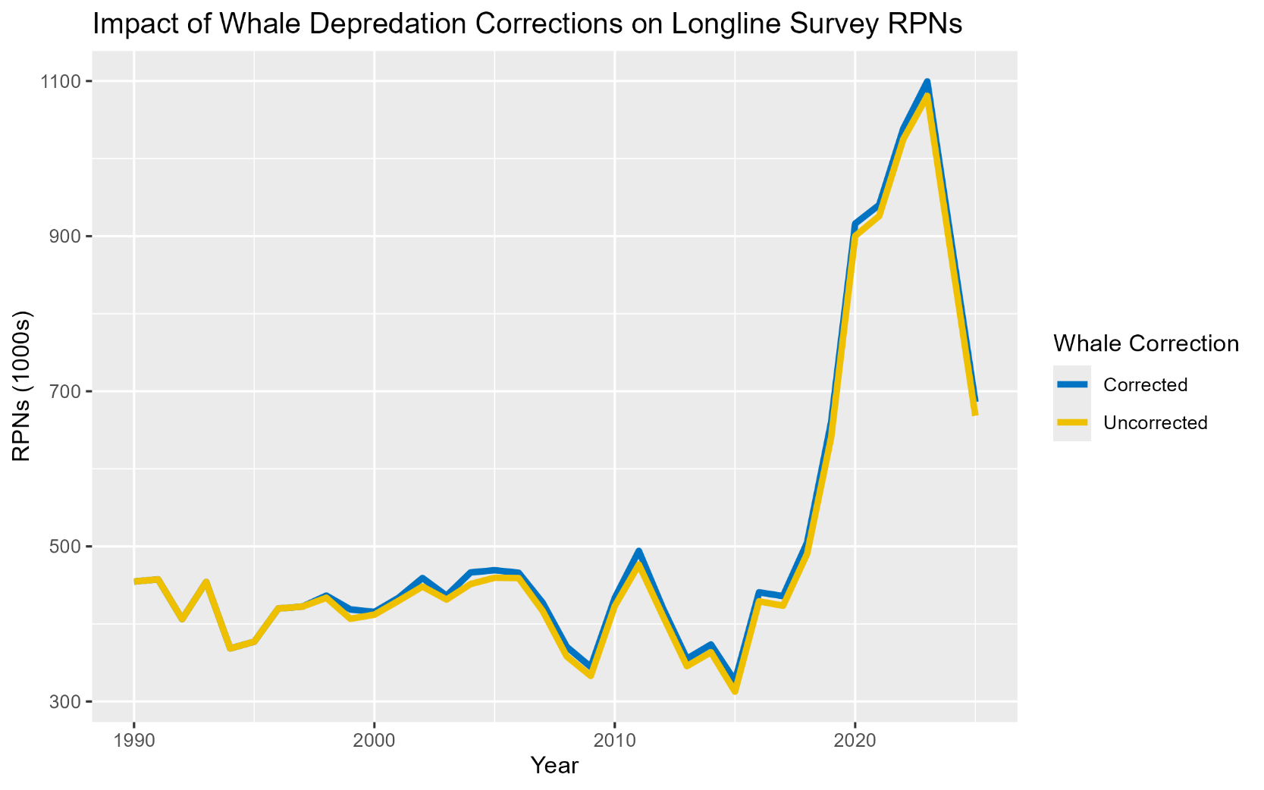
Whale Depredation
Fishery whale depredation no longer updated annually (full update in 2022)
Limited depredation due to rapid transition to pot gear (no assumed depredation)
Totals ~ 131 mt annually
Sperm whale depredation effect on longline survey is low and the area RPNs are adjusted using a fixed scalar of 1.18 for affected stations (relatively small number of stations)
Killer whale depredated stations are removed from the RPNs
*Note figure does not include non-surveyed area extrapolations

Slide 7
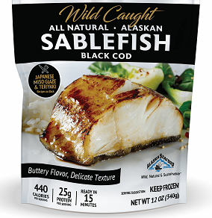
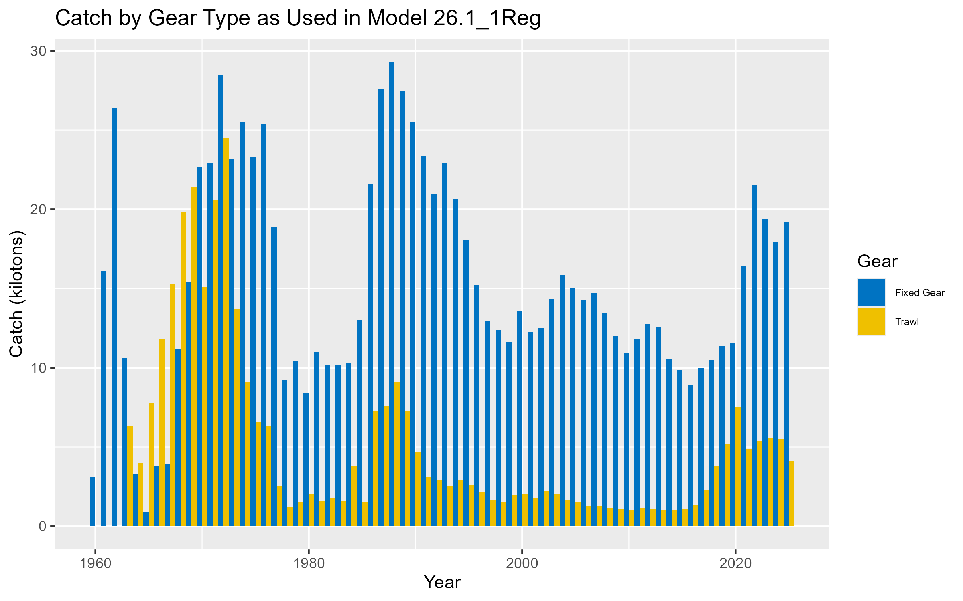
Catch
Catch is aggregated to two fleets (fixed gear and trawl gear) for the assessment
Catch is summed across regions and gear types within fleets
Combines Japanese and domestic fleets
Fixed gear fleet includes hook-and-line and pot gear
Increased from ~15% in 2017 to ~85% pot gear in 2025
Additional catch added from:
Non-commercial catch (~200 -- 500 mt annually), primarily from LLS
Whale depredation (~131 mt annually)
Trawl fleet is 10 – 30% of domestic total catch and includes:
Pelagic gear -- primarily eastern Bering Sea (EBS) shelf pollock fleet
Bottom trawl gear – in AI+GOA where occasionally have set specific sablefish targeting (trip ‘top-off’)

Slide 8
Fixed Gear Fishery Age Compositions
Random otolith collection by observers (~2,000 – 5,000 total specimens) since 1999
~1,200 otoliths aged per year by AFSC
Available on a one-year lag to the assessment
Post collection a random sampling protocol (e.g., across size, sex, and haul) is implemented, which selects otoliths for aging from all otoliths collected
Aim for ~200 per each of six management regions
Strong reductions in recent years due to Electronic Monitoring and changes in observer coverage

Slide 9
Fixed Gear Fishery Age Compositions
Annual Alaska-wide catch-weighted (in numbers)age compositions produced (mean across regions)
Use catch in numbers to better represent recruitment
Produce representative compositions from across Alaska without overweighting regions with low catch
Emphasizes signals from GOA (high catch, high sample sizes)
…but the AI plus group is an enigma….
Alaska-wide Female Age Comps
AI Age Comps

Slide 10
Fixed Gear Fishery Length Compositions (Not Used)
Observer collected length samples available since 1990
~12,000 – 30,000 per year
Available on one year lag for assessment
Annual Alaska-wide catch-weighted length compositions produced
Not currently used since already fitting age compositions
Increased potential for process error in fitting lengths in an age-structured assessment

Slide 11
Trawl Fishery Length Compositions
Observer collected length samples available since 1990
~500 – 6,000 per year
Available on one year lag for assessment
Annual Alaska-wide catch-weighted length compositions produced
Often bi-modal due to the aggregation across gears that have distinct interactions with sablefish
Pelagic trawl primarily interacts with juvenile sablefish
No age data available from trawl fleets

Slide 12
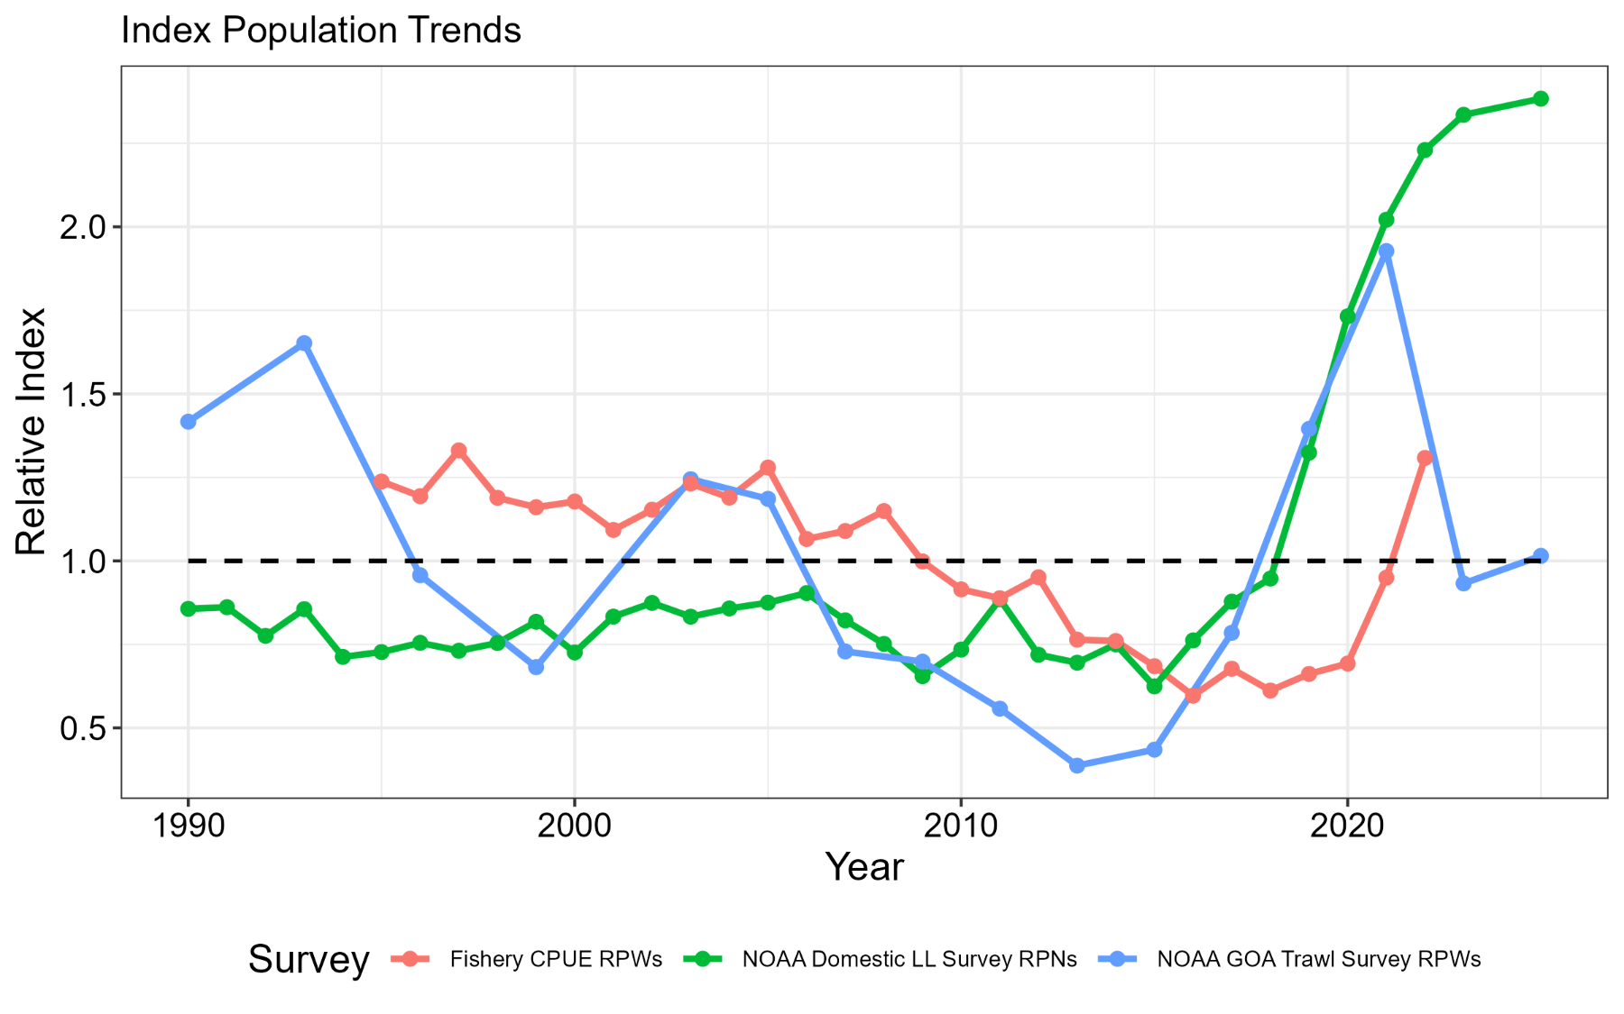
Indices of Abundance/Biomass
Three indices available to inform sablefish population trends:
NOAA Longline Survey – sablefish directed survey sampling across Alaska
NOAA Gulf of Alaska Trawl Survey – multispecies survey sampling juvenile sablefish in the GOA
Fixed Gear Fishery CPUE – standardized CPUE index from observer and logbook data, primarily in GOA
LL Survey: Slight Increase
CPUE Index: No Update
Trawl Survey:
Slight Increase

Slide 13
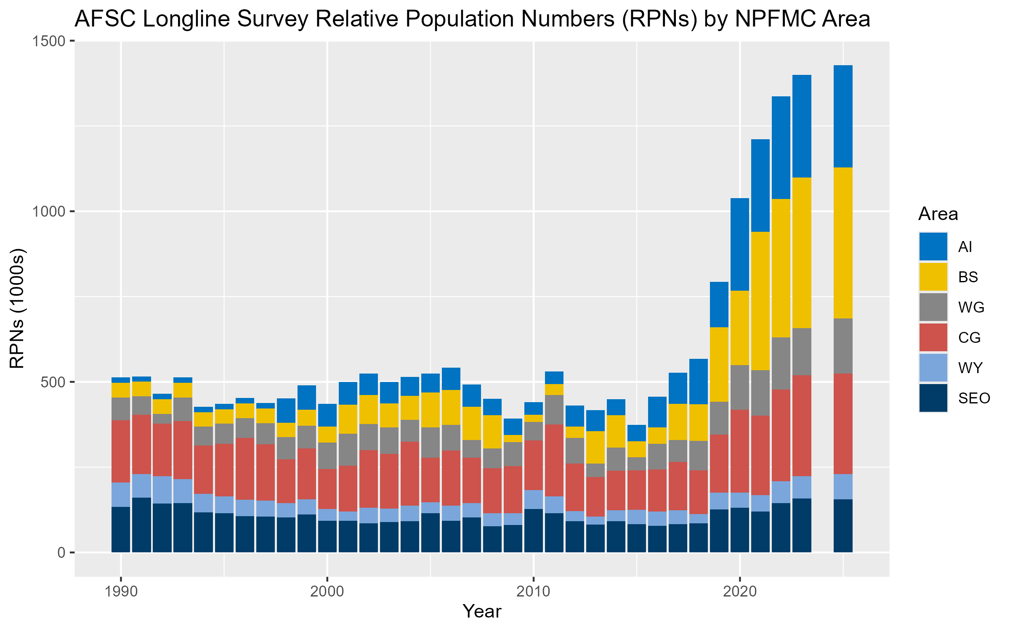
NOAA Longline Survey Index
Extrapolated relative population numbers (RPNs) are required to ensure consistent AK-wide scaling
Prior to 2025 change in GOA used to extrapolate BS or AI from previous year (No Longer Feasible)
Since 2025 ‘carryover’ approach maintains the previous area-specific RPN for any unsampled area
Extrapolating ~50% of the RPNs under new survey design, given recent sablefish distribution and catch rates in BS+AI
Prior to 2026 utilized extrapolations for western AI (wAI) stations based on Japanese LLS data and outdated area sizes
Removed in 2026 resulting in ~2 – 10% index reduction

Slide 14
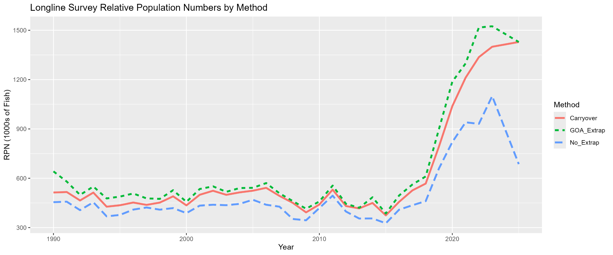
NOAA Longline Survey Index
GOA Extrapolation (include wAI)
Carryover Extrapolation (exclude wAI)
No Extrapolation (exclude wAI)

Slide 15
NOAA Longline Survey Age Compositions
Random otolith collection by scientists (~1,500 – 4,000 total specimens) since 1996
~1,200 otoliths aged per year, but only ~900 from stations used in the index
Available on a one-year lag to the assessment
Random sampling:
Before 2025 aimed for ~200 each from EG/CG/WG and 300 from BS or AI
Since 2025 aim for ~300 each from EG/CG/WG in odd years and 600 each from BS/AI in even years
Annual Alaska-wide RPN-weighted age compositions produced

Slide 16
NOAA Longline Survey Length Compositions (Not Used)
Observer collected length samples available since 1990
~40,000 – 90,000 per year
Available in-year for assessment
Annual Alaska-wide RPN-weighted length compositions produced
Not currently used in assessment since already fitting age compositions

Slide 17
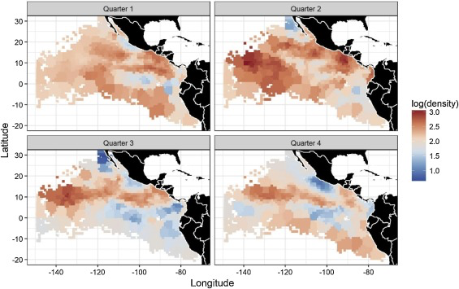
NOAA Longline Survey Index – Alternatives?
Model-based methods
Unlikely to be effective if certain areas have never been sampled simultaneously or if extrapolating over large areas
Added difficulty interpolating given nature of data (fixed stations/longline gear)
Ad-hoc imputation
Fill in missing values with historical values
Risks biases if historical values are not reflective of current conditions
Regional indices and compositions
Fit data at the ~scale at which they were collected
Data sparsity issues for lesser sampled regions
Xu et al 2019

Slide 18
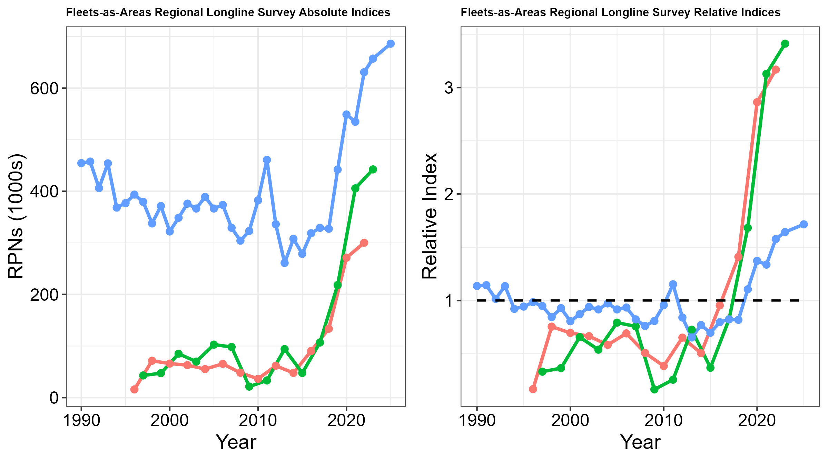
NOAA Longline Survey Regional Indices
For fleets-as-areas (FAA) model, disaggregated indices (BS, AI, GOA) were produced
GOA aggregated across associated regions (EG/CG/WG)
No extrapolation necessary (unsampled regions treated as missing data; no placeholder)
Dropped western AI extrapolated stations (matching single region index)
RPNs
Relative to Regional Mean
Bering Sea (BS)
Aleutian Islands (AI)
Gulf of Alaska (GOA)

Slide 19
NOAA Longline Survey Regional Age Compositions
For BS and AI, raw age compositions used (no weighting)
For GOA, RPN-weighted age compositions produced
Sample sizes in BS/AI are half of those in GOA (300 vs. 600)
AK-wide and GOA age compositions generally align
BS
AI
GOA

Slide 20
Japanese Longline Survey
NOAA Longline Survey essentially adopted similar methods as historical Japanese LLS
Japanese LLS RPNs available from 1979 – 1994
Length-stratified age compositions available sporadically
~800 – 1,700 samples
Length compositions available annually
~18,000 – 120,000 samples
Integrated into assessment to enable estimation of selectivity
AK-wide RPN-weighted age/length compositions produced

Slide 21
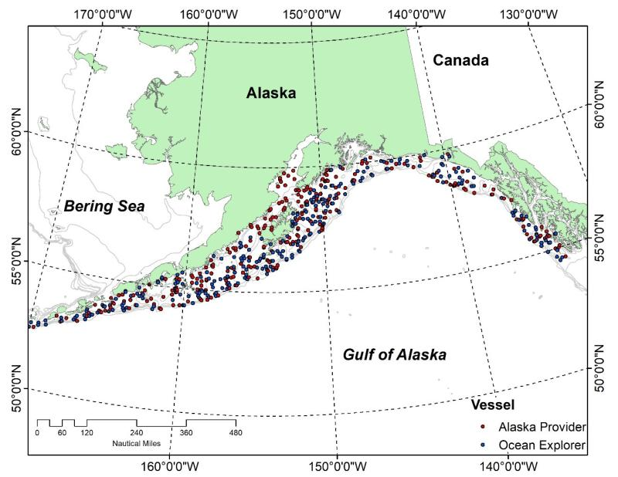

Trawl Survey Index and Length Compositions (Not Used)
Multispecies survey of the continental shelf to 500m
Random stratified survey design
Triennial (1990 – 2003), biennial (2003 – Present)
1,000 – 8,000 length samples taken per survey (no otoliths aged)
Data Issues (Representativeness):
Only covers the GOA
BS and AI trawl surveys have shorter time series and more sporadic catch of sablefish
Only consistently surveys < 500m, which is shallower than prime sablefish habitat
Primarily catches only juvenile (smaller) sablefish
Hanselman et al., 2007

Slide 22
Trawl Survey Index and Length Compositions (Not Used)
Integrated in 2007 as a recruitment index
Removed in 2025
Appropriate selectivity is difficult to define
Has high influence on recent recruitment estimates in the assessment
Increases variability in recruitment signals since it is assumed to select ~100% of age-2 fish
Often contradicts LLS composition data leading to recruitment retrospective patterns
Recent signals differ greatly from LLS (e.g., 2023 and 2025 declines)
Male Trawl Survey Selectivity
Trawl Survey Female Lengths
Longline Survey Female Lengths
Recruitment Retrospective Patterns
w/ Trawl Survey
w/o Trawl Survey

Slide 23
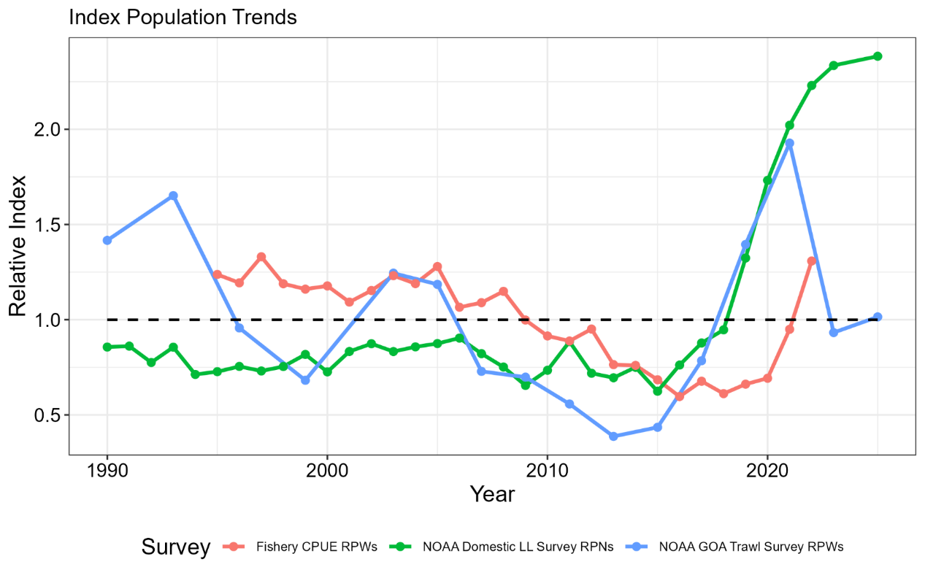
Fixed Gear CPUE (Not Used)
Nominal Japanese longline CPUE (1964 – 1981)
Reported in Sasaki (1985)
Standardized domestic fixed gear CPUE (1995 – 2022)
Records of catch and effort for sablefish targeting vessels are collected by observers and reported in logbooks, primarily in GOA
A combined fixed gear standardized CPUE index was developed
Can no longer be updated (logbooks not provided to NOAA)
Trends mostly align with LLS RPNs, with lag (represents mature biomass)
Data and assessment issues:
Difficulty standardizing across management regimes
Assume a high CV compared to LLS, so provides minimal information to assessment

Slide 24
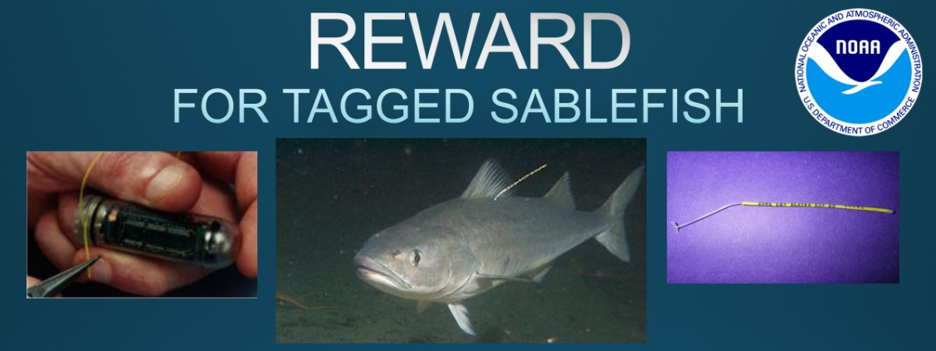
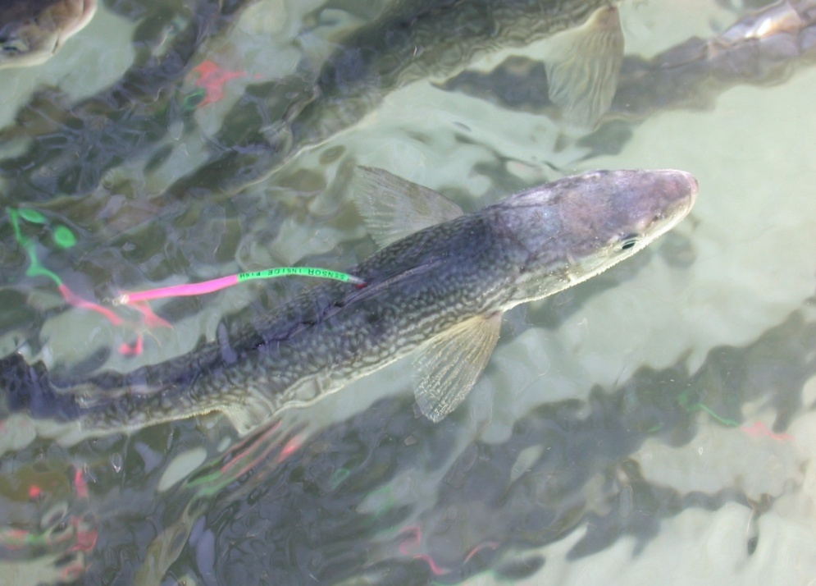
Mark Recapture Data
Tagging with conventional tags since 1970s (~413,000 releases)
~ 3,500 adult sablefish tagged per year on the LLS
~ 100 – 1,000 juvenile (age-1) sablefish tagged per year in nursery areas in the EG
Data collected includes location, date, length, depth, and gear
Recaptures (~38,500):
Data collected includes location, time at liberty, depth, size, and otolith (survey recaptures)
Average distance between release and recapture is 340 nm
Furthest recovery was 2,586 nm
Fastest traveled 116 nm in 6 days
Longest time at liberty >39 yrs
Uses:
Estimating growth, ageing error (known-age studies), movement rates, catch apportionment, and movement patterns
Integrated directly into the spatial assessment models

Slide 25
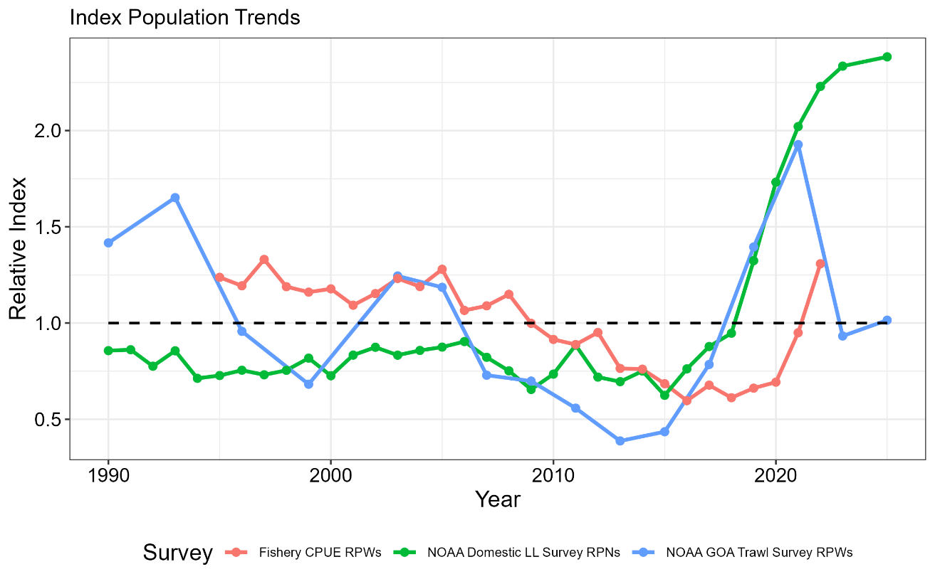
Key Considerations for Assessment
LLS represents best scientific information available on sablefish trends, but difficult to account for survey changes
Is it better to fit extrapolated data or disaggregated data (with lower composition sample sizes)?
Should alternative indices be integrated (CPUE or trawl survey), if they reflect dynamics of a subset of the population (e.g., GOA-only, juveniles or mature fish)
Need to integrate size-age transition matrix to fit trawl fishery and Japanese LLS length compositions
Is there benefit (or increased process error) from fitting age and length compositions simultaneously (e.g., for LLS and fixed gear fishery)?

Slide 26
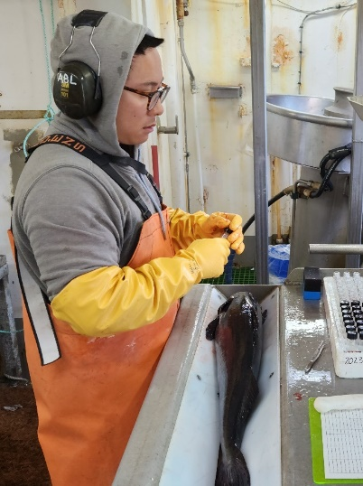
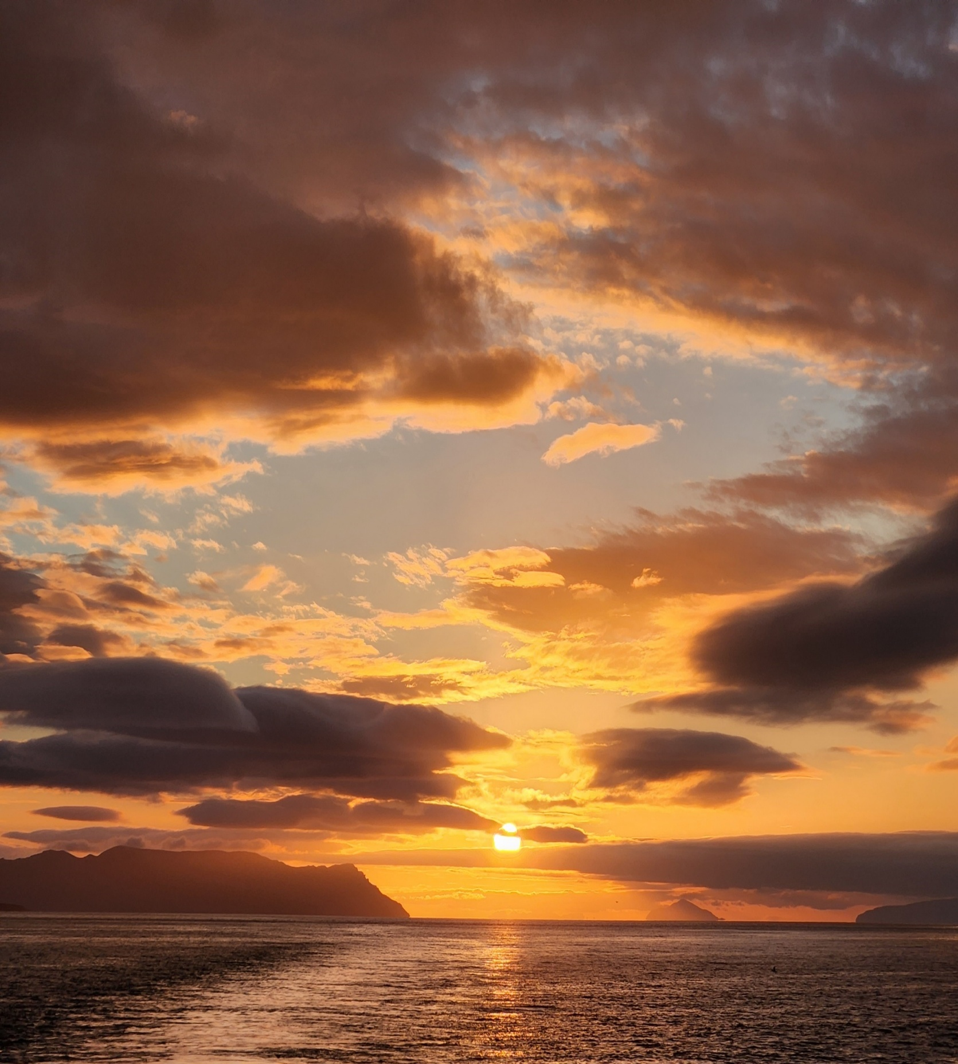
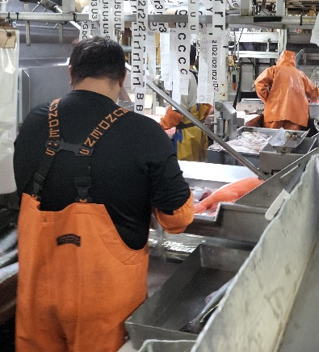
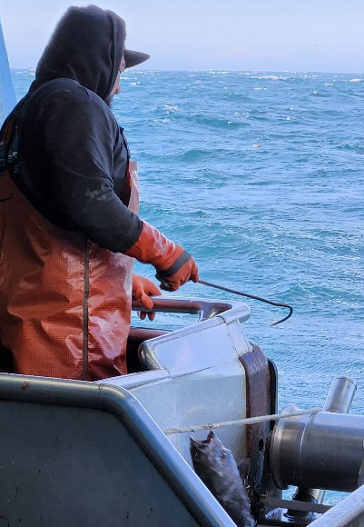
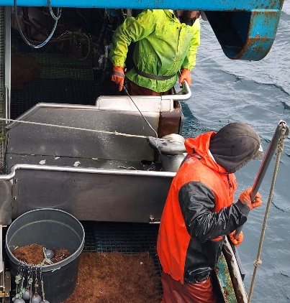
QUESTIONS?

Slide 27
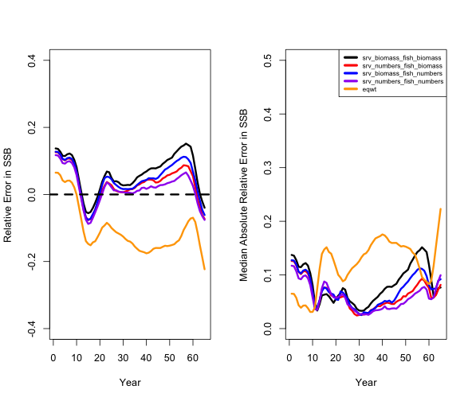
Abundance vs. Biomass Weighted Compositions

